Slide 1
Ch.12 Characters and Strings

Slide 2

What you will learn in this chapter
Since humans use characters to express information, strings occupy an important position in programs . In this chapter, we will take a closer look at string handling methods in C.
How to express characters
How to represent strings
What is a string ?
Input/output of strings
Character processing library functions
Standard Input/Output Library Functions

Slide 3
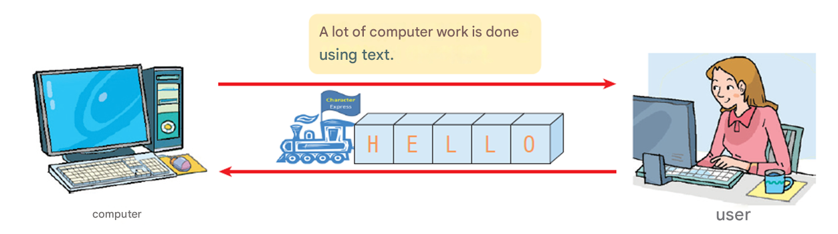
The importance of letters
Text is of utmost importance to humans .

Slide 4
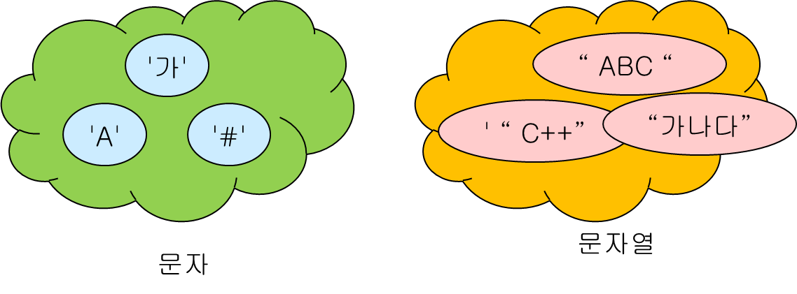
Characters and strings
Characters
Strings

Slide 5
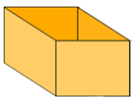
How to represent strings
string : A collection of several characters
"A＂
"Hello World!"
" The value of variable score is %d "
String variable
A variable that can store a mutable string.
Where is a good place to save it ?
H
One character is stored in a char type variable.
H
E
L
L
o
\0
Strings are stored as char type arrays

Slide 6
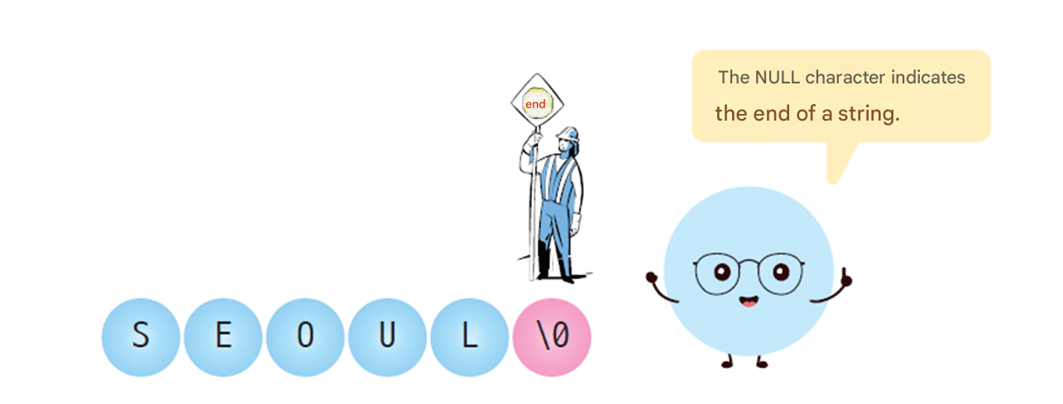
NULL character
NULL character : Indicates the end of a string .
? ?

Slide 7


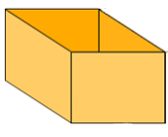
Why do we need to mark the end of a string ?
Since we don't know where the string ends, we need to mark it .
“ seou ”,
“ seoul ”,
“ seoul #”,
“ seoul #%”,
....
???
? ?
? ?
Garbage value
s
e
o
u
l
#
%
?
&
$
str [ 0] str [1] str [2] str [3] str [4] str [5] str [6] str [7] str [8] str [9]

Slide 8

Example #1
#include < stdio.h >
int main( void )
{
int i ;
char str [4];
str [0] = 'a';
str [1] = 'b';
str [2] = 'c';
str [3] = '\0';
i = 0;
while ( str [ i ] != '\0' ) {
printf ( "%c" , str [ i ]);
i ++;
}
return 0;
}
Let's print out the characters in the character array one by one . When printing a string stored in a character array, you can use %s , but here, in order to experience the basic method of string processing, we print out the characters in the character array one by one on the screen and stop the repetition when a NULL character is encountered .
abc

Slide 9
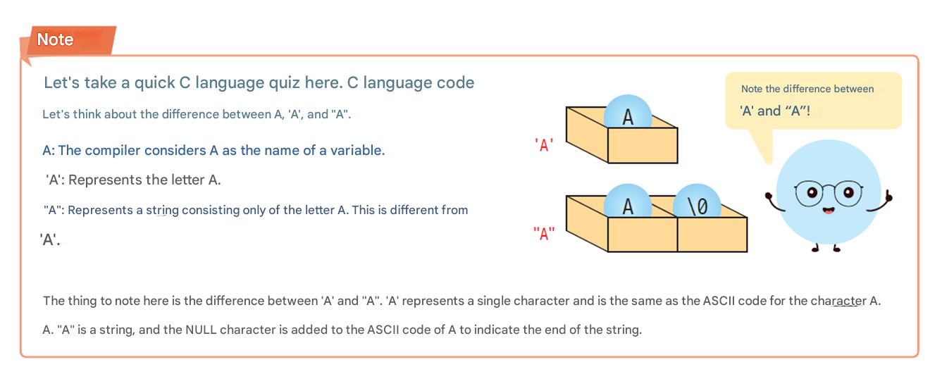
reference

Slide 10
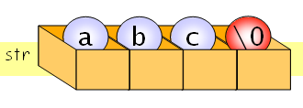





Initializing a character array
char str [4] = { 'a', 'b', 'c', '\0' };
char str [4] = "abc";
char str [4] = "abcdef";
char str [6] = "abc";
char str [4] = "";
char str [] = "abc";
char str[]; Error → The compiler doesn't know how much memory to allocate.

Slide 11
Output of string
abc
char str [] = “abc”;
printf (“%s”, str );
abc
char str [] = “abc”;
printf ( str );

Slide 12
Example #2
#include < stdio.h >
int main( void )
{
char str1[6] = "Seoul" ;
char str2[3] = { ' i ' , 's' , '\0' };
char str3[] = "the capital city of Korea." ;
printf ( "%s %s %s\n" , str1, str2, str3);
return 0;
}
Seoul is the capital city of Korea.
S
e
o
u
l
\0
str1
str1 [ 0] str1 [1] str1 [2] str1 [3] str1 [4] str1 [5]
i
s
\0
str2
str2 [ 0] str2 [1] str2 [2]
t
h
e
' '
....
K
o
r
e
a
\0
str3
str3 [ ] str3 [ ] str3 [ ] str3 [ ] . . . . str3 [ ] str3 [ ] str3 [ ] str3 [ ] str3 [ ] str3 [ ]

Slide 13
Example #3
#include < stdio.h >
int main( void )
{
char src [] = "Action speaks louder than words" ;
char dst [100];
int i ;
printf ( " Original string =%s\n" , src );
for (i = 0; src[i] != '\0' ; i++)
dst [ i ] = src [ i ];
dst [ i ] = '\0' ;
printf ( " Copied string =%s\n" , dst );
return 0;
}
NULL and '\0' are the same .
Original string =Action speaks louder than words
Copied string =Action speaks louder than words

Slide 14
Example of calculating string length
// Program to find the length of a string
#include < stdio.h >
int main( void )
{
char str [30] = "C language is easy";
int i = 0;
while ( str [ i ] != 0)
i ++;
printf ( " The length of the string \"%s\" is %d .\n" , str , i );
return 0;
}
String "C language is The length of "easy" is 18.

Slide 15
How to change the character array
1. The first method is to individually assign the desired character to each array element. This is a surefire way, but very inconvenient .
char str[10]=“Hello”;
str[0] = 'W';
str[1] = 'o';
str[2] = 'r';
str[3] = 'l';
str[4] = 'd';
str[5] = '\0';
2. You can copy a string to a character array using the library function strcpy () .
char str[10]=“Hello”;
strcpy (str, "World");

Slide 16
Wrong way
3. The following method , which seems to be the most convenient , cannot be used . Please be careful .
char str[10] = "Hello";
str = "World"; // Grammatical error !
As we learned in arrays, the name of
an array is a pointer constant that points to the array. It cannot be changed.

Slide 17
String constant
String constant : Strings included in the program source code such as “HelloWorld”.
String Constants are stored in text segment among the memory areas.
char *p = " HelloWorld ";
What exactly does the above sentence mean ?

Slide 18
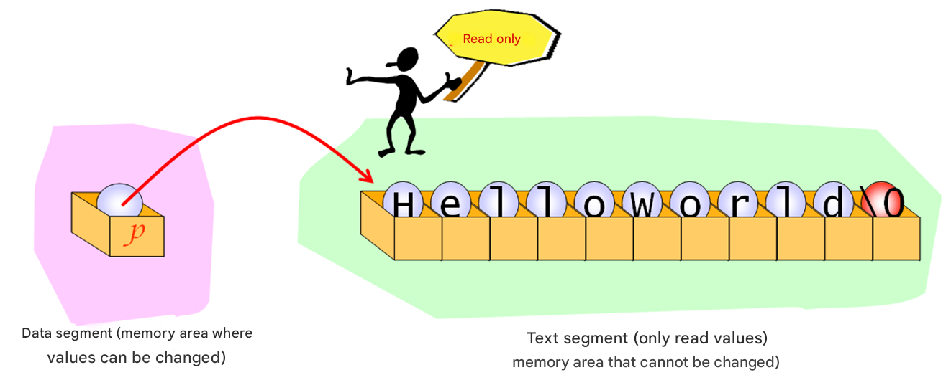
String constant
char *p = " HelloWorld ";

Slide 19
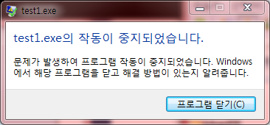
String constant
char *p = "HelloWorld";
strcpy (p, “Goodbye”);
An error occurs when trying to store characters in a text segment via p .
Text segments cannot be changed .

Slide 20
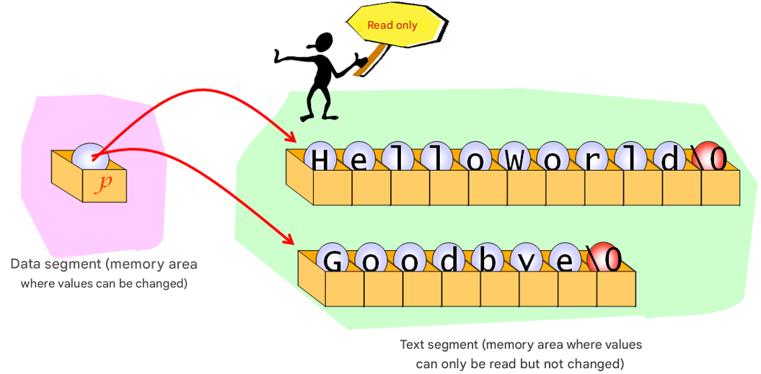
String constant
char *p = " HelloWorld ";
p = "Goodbye";
OK!

Slide 21
Example
#include < stdio.h >
int main( void )
{
char * p = "HelloWorld" ;
printf ( "%s \n" , p);
p = "Welcome to C World!" ; // possible
printf ( "%s \n" , p);
p = "Goodbye" ; // possible
printf ( "%s \n" , p);
// p[0] = 'a'; // An error occurs .
return 0;
}
HelloWorld
Welcome to C World!
Goodbye

Slide 22

Check points
How are strings defined in C ?
What is the role of the NULL character in a string ?
What is the ASCII code value of the NULL character ?
What happens if I print a string that doesn't end with a NULL character ?
Explain the difference between B, 'B', and "B" .
Where are mutable strings stored ?
Why is the size of the character array one larger than the size of the string ?
How to initialize a character array to a string.

Slide 23
Character input/output library
Input/output functions | explanation
int getchar(void) | Reads and returns a single character.
void putchar(int c) | Prints the character stored in variable c.
int _getch(void) | Reads and returns a single character ( without using a buffer ).
void _putch(int c ) | Prints the character stored in variable c ( without using a buffer ).
scanf("%c", &c) | Read one character and store it in variable c.
printf("%c", c); | Prints the character stored in variable c.
program
… 'A' 'B' 'C' ...

Slide 24

getchar (), putchar ()
putchar ()
Variable
B
Variable
A
B
getchar ()

Slide 25
getchar(), putchar()
// Usage of
#include < stdio.h >
int main( void )
{
int ch ; // Note the use of integers
while ( ( ch = getchar ()) != EOF )
putchar ( ch );
return 0;
}
Character indicating End Of File ,
EOF is an integer -1 .
a
a
b
b
^Z

Slide 26
EOF
EOF(End Of File): A special symbol indicating the end of input.
program
EOF
getchar()
…
ctrl+z

Slide 27
The return value of getchar() Why it's an integer
The return type of getchar() is “int” to distinguish the ASCII code from EOF.
If you use a 32 -bit int type, you can clearly distinguish between the ASCII code (0x000000000 to 0x000000FF) and EOF (0xFFFFFFFF), which is a 32- bit int type -1. (It's impossible to do with 8 bits).
00000000 to 0x000000FF
ASCII code character (only the lower 8 bits of 32 bits are used )
getchar()
EOF
0xFFFFFFFF(-1)

Slide 28
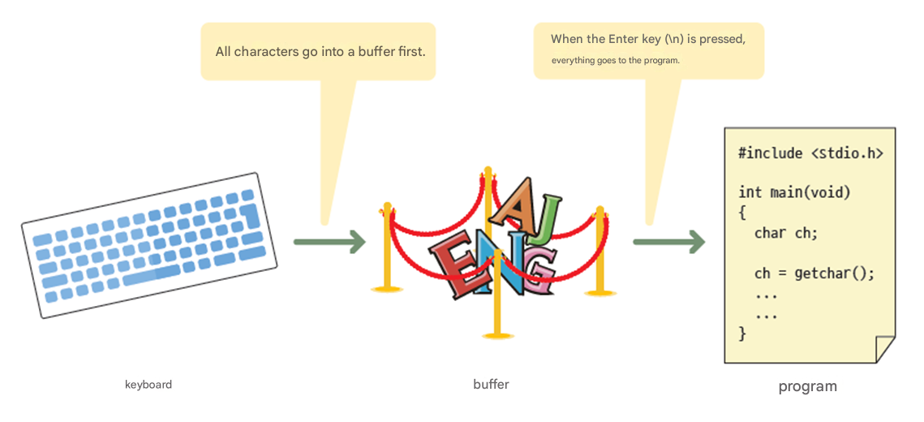
Buffering
press Enter to get input?
OS Kernel memory space

Slide 29
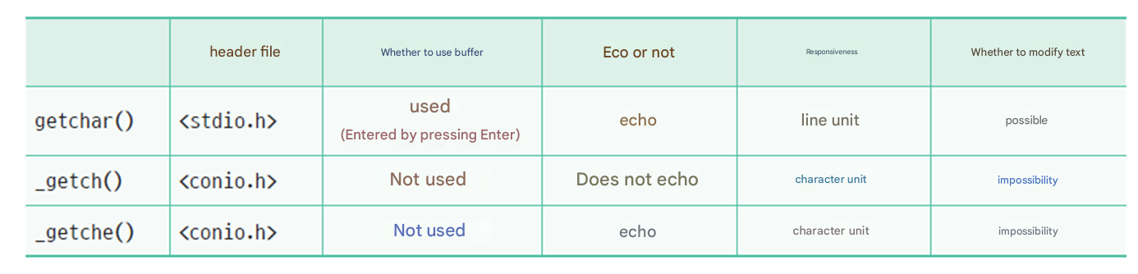
_getch (), _getche ( ), getchar ( )
Choose the one that suits your purpose !
If you want to receive it immediately without buffering, use _getch( ) .

Slide 30
_ getch(), _ putch()
Useful for editing programs!
#include < stdio.h >
#include < conio.h >
int main( void )
{
int ch ;
while (( ch = _ getch ()) != 'q’ )
_ putch( ch );
return 0;
}
Do not use buffers ,
No echo !
abc

Slide 31
String input/output library functions
Input/output functions | explanation
int scanf("%s", s) | Read a string and store it in a character array
int printf("%s", s) | Prints the string stored in array s[].
char * gets_s(char *s, int size) | Read a line of string and store it in the character array s[] .
int puts(const char *s) | Prints a single line of string stored in array s[].
Windows
program
… Hello World!...

Slide 32
Example
#include < stdio.h >
int main( void )
{
char name[100];
char address[100];
printf ( "Enter your name : " );
scanf ( "%s" , name);
printf ( "Enter your current address : " );
scanf ( "%s" , address);
printf ( "Hello , Mr. % s who lives in %s .\n" , address, name);
return 0;
}
The address is not fully saved.
Enter your name : Hong Gil-dong
Enter your current address : 1 Jongno -gu, Seoul
Hello . I am Hong Gil-dong living in Seoul .

Slide 33
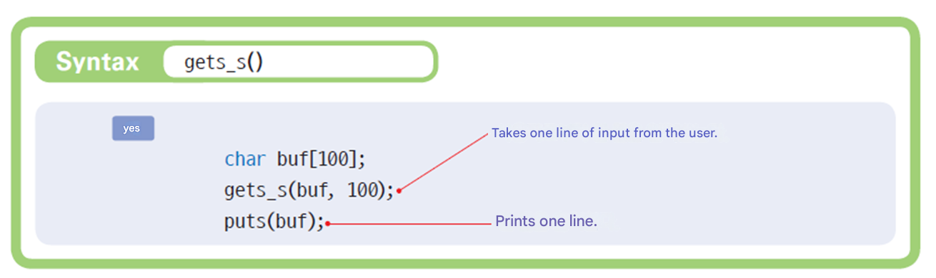
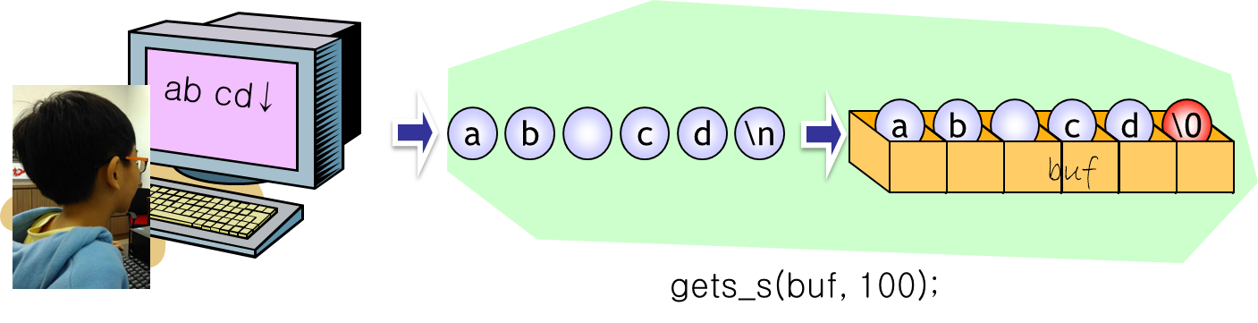
gets_s () and puts() string input/output

Slide 34
Example
#include < stdio.h >
int main( void )
{
char name[100];
char address[100];
printf ( “Enter your name : “ );
gets_s (name, sizeof (name));
printf ( “Enter your current address : “ );
gets_s (address, sizeof (address));
printf ( “Hello , Mr. % s who lives in %s .\n” , address, name);
return 0;
}
Used when entering more than one word .
Enter your name : Hong Gil-dong
Enter your current address : 1 Jongno -gu, Seoul
Hello ? I am Hong Gil-dong, living at 1 Jongno-gu, Seoul .

Slide 35
Character processing library functions
Check or convert characters .
Function | explanation
isalpha (c) | Is c an English letter ? (az, AZ)
isupper (c) | Is c uppercase ? (AZ)
islower(c) | c lowercase ? (az)
isdigit (c) | Is c a number ? (0-9)
isalnum(c) | c a letter or a number ? (az, AZ, 0-9)
isxdigit(c) | Is c a hexadecimal number ? (0-9, AF, af)
isspace(c) | Is c a space character ? (' ', '\n', '\t', '\v', '\r')
ispunct(c) | Is c a punctuation character ?
isprint(c) | C a printable character ?
iscntrl(c) | Is c a control character ?
isascii(c) | c an ascii code ?

Slide 36
Character processing library functions
Check or convert characters .
Function | explanation
toupper(c) | c to uppercase .
tolower(c) | c to lowercase .
toascii(c) | c to ASCII code .

Slide 37
Example
#include < stdio.h >
#include < ctype.h >
int main( void )
{
int c;
while ((c = getchar ()) != EOF)
{
if ( islower (c) )
c = toupper (c);
putchar (c);
}
return 0;
}
Check if it is lowercase
Convert to uppercase
abcdef
ABCDEF
^ Z
To input EOF from your keyboard, type ^Z

Slide 38
Lab: Words century
Let's write a program that counts the number of words in a string. If the string is “the c book…” , the output will be as follows :
Number of words : 3

Slide 39
Example
#include < stdio.h >
#include < ctype.h >
int count_word ( char * s );
int main( void )
{
int wc = count_word ( "the c book..." );
printf ( " Number of words : %d \n" , wc );
return 0;
}

Slide 40
Example
int count_word ( char * s )
{
int i , wc = 0, waiting = 1;
for ( i = 0; s [ i ] != NULL ; ++ i ) // Examine each letter of
if ( isalpha ( s [ i ])) // If the letter of
{
if (waiting) // If you are waiting for a word
{
wc ++; // increment the counter
waiting = 0; // Processing words
}
}
else // if it is not an alphabet
waiting = 1; // Wait for a word .
return wc ;
}

Slide 41
Lab: Check valid password
A valid password must be at least 7 characters long , contain at least one lowercase letter, at least one uppercase letter, and at least one number .
Enter your password : abc1234
The password is not valid .

Slide 42
Solution
#include < stdio.h >
#include < string.h >
#include < ctype.h >
int main( void )
{
int lower_case_count = 0; // Number of lowercase letters
int upper_case_count = 0; // Number of uppercase letters
int digit_count = 0; // number of digits
char pass[100];
int len ;
printf ( " Enter your password : " );
gets_s (pass, sizeof (pass));

Slide 43
Solution
len = strlen (pass); // length of the string
if ( len < 7) {
printf ( " Not a valid password .\n" );
exit(1);
}
for ( int i = 0; i < len ; i ++) {
if ( islower (pass[ i ])) ++ lower_case_count ;
if ( isupper (pass[ i ])) ++ upper_case_count ;
if ( isdigit (pass[ i ])) ++ digit_count ;
}
if ( lower_case_count > 0 && upper_case_count > 0 && digit_count > 0)
printf ( " This is a strong password . \n" );
else
printf ( " Not a valid password \n" );
return 0;
}

Slide 44
Check points
What header files must I include to use the character processing library functions ?
What is the difference between getchar() and getch() ?
What is the return value of ispunct('.') ?
What is the return value of toupper('a') ?

Slide 45
String processing library
String functions are declared in string.h. Therefore, to use these functions, you must include string.h at the beginning of your program.
Function | explanation
strlen(s) | Finds the length of string s .
strcpy(s1, s2) | Copy s2 to s1 .
strcat(s1, s2) | Paste s2 to the end of s1 .
strcmp(s1, s2) | Compare s1 and s2 .
strncpy(s1, s2, n) | Copy at most n characters from s2 to s1 .
strncat(s1, s2, n) | Paste at most n characters from s2 to the end of s1 .
strncmp(s1, s2, n) | Compares s1 and s2 up to n characters .
strchr(s, c) | Finds the character c in string s .
strstr(s1, s2) | Find string s2 in string s1 .

Slide 46
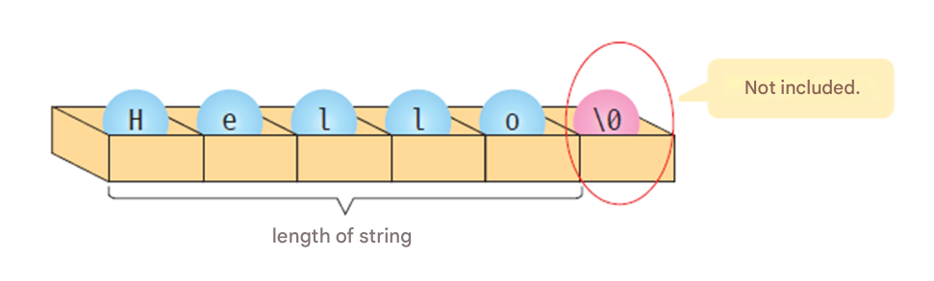
Length of string
The function to calculate the length of a string is strlen (const char *str) .
int size = strlen ("Hello"); // size becomes 5 .

Slide 47
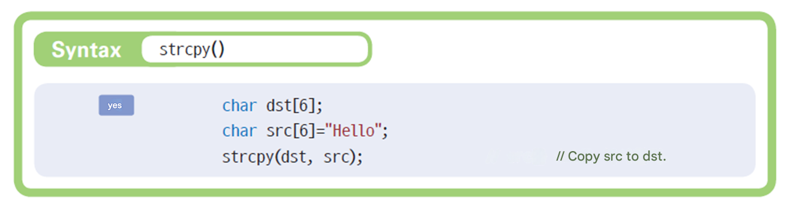
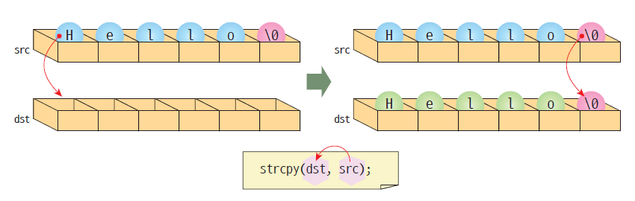
Copy string

Slide 48
String copy animation
char dst [6];
char src [6] = “Hello";
strcpy ( dst , src );
H
e
l
l
o
\0
src
H
e
l
l
o
\0
dst

Slide 49
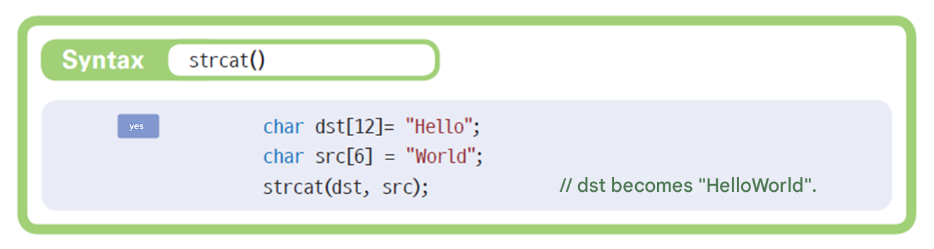
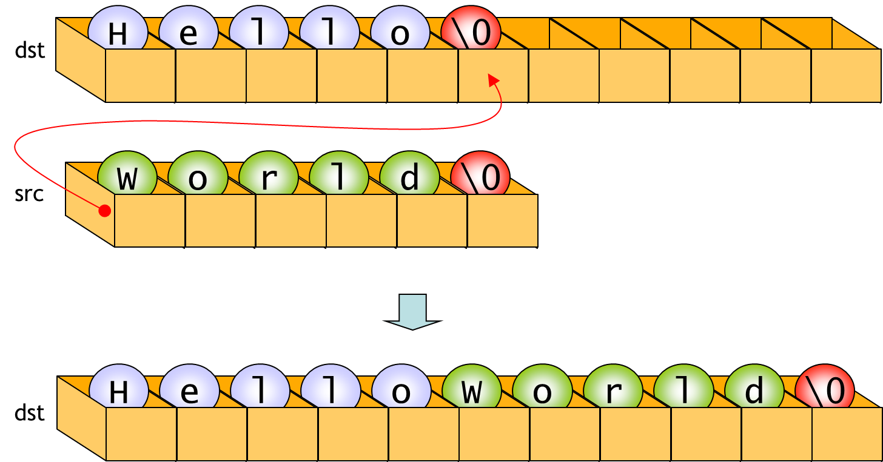
String concatenation

Slide 50
String concatenation animation
char dst [12] = "Hello";
char src [6] = "World";
strcat ( dst , src );
H
e
l
l
o
\0
W
o
r
l
d
\0
W
o
r
l
d
\0
dst
src

Slide 51
Example
// strcpy and strcat
#include < string.h >
#include < stdio.h >
int main( void )
{
char string[80];
strcpy ( string, "Hello world from " );
strcat (string, " strcpy " );
strcat ( string, "and " );
strcat ( string, " strcat !" );
printf ( "string = %s\n" , string );
return 0;
}
string = Hello world from strcpy and strcat !

Slide 52
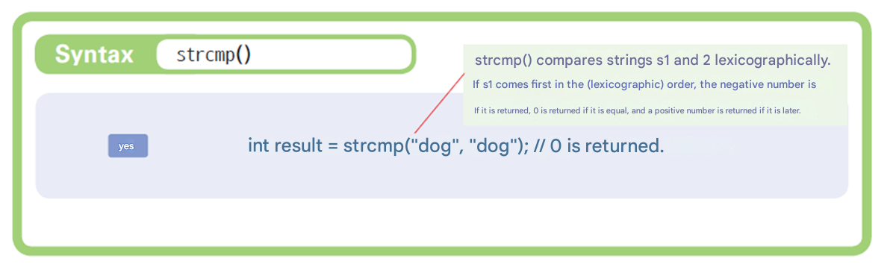
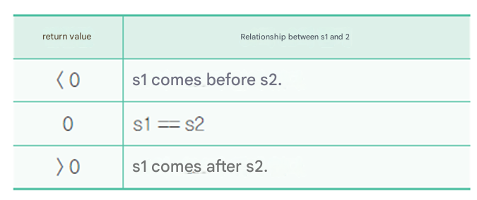
String comparison
The string If they are equal, strcmp ( ) returns

Slide 53
Example
// strcmp () function
#include < string.h >
#include < stdio.h >
int main( void )
{
char s1[80]; // first The word To save Character array
char s2[80]; // second The word To save Character array
int result;
printf ( " first The word Enter :" );
scanf ( "%s" , s1);
printf ( " second The word Enter :" );
scanf ( "%s" , s2);

Slide 54
Example
result = strcmp (s1, s2);
if ( result < 0 )
printf ( "% s is greater than % s" in front There are .\n" , s1, s2);
else if ( result == 0 )
printf ( "% s is % s and are the same .\n" , s1, s2);
else
printf ( "% s is greater than % s" behind are .\n" , s1, s2);
return 0;
}
Alphabetically, meaning it is at the front in the dictionary
Enter the first word : cat
Enter the second word : dog
cat comes before dog.

Slide 55
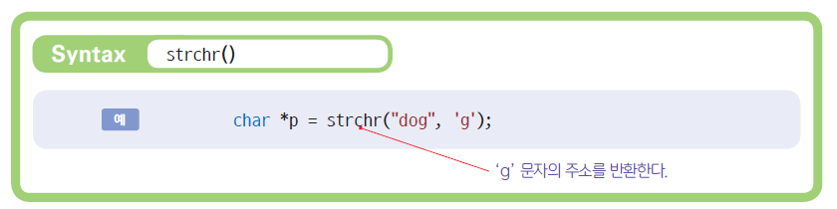
Text search
To check whether a given string contains a specific character, use strchr() .

Slide 56
Text search
#include < string.h >
#include < stdio.h >
int main( void )
{
char s[] = "language";
char c = 'g';
char *p;
int loc;
p = strchr (s, c);
if ( p == NULL )
printf ( "%c not found \n" , c );
else {
loc = ( int )(p - s);
printf ( " First %c in %s found in %d \n" , c, s, loc);
}
return 0;
}
Search the letter c in string s
First g in language was found in 3

Slide 57
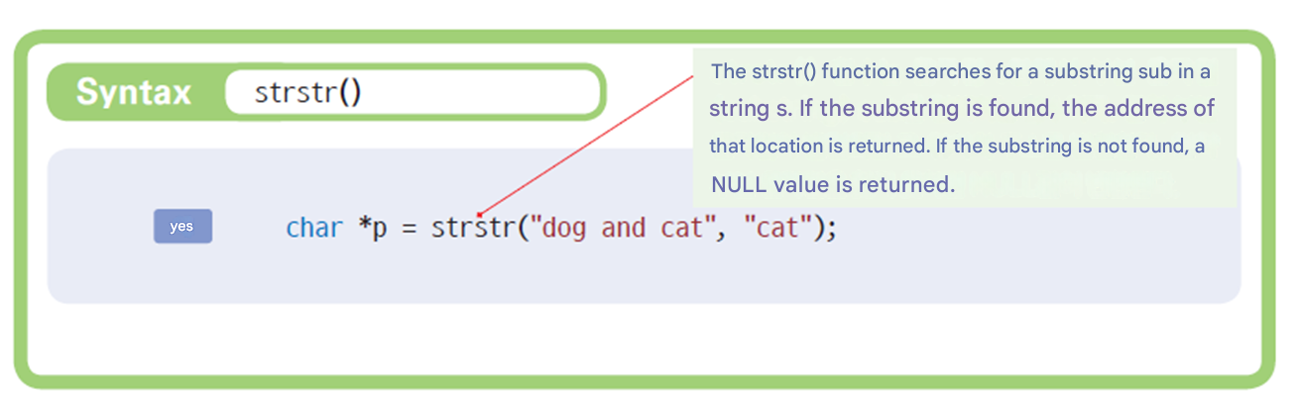
String search
To search for a specific string within a given string, use strstr ().

Slide 58
String search
#include < string.h >
#include < stdio.h >
int main( void )
{
char s[] = "A bird in hand is worth two in the bush";
char sub[] = "bird";
char *p;
int loc;
p = strstr (s, sub);
if ( p == NULL )
printf ( "%s not found \n" , sub );
else {
loc = ( int )(p - s);
printf ( " First %s in % s found in %d\n" , sub , s, loc );
}
return 0;
}
Search sub​ string in string s
First bird in A bird in hand is worth two in the bush was found in 2

Slide 59
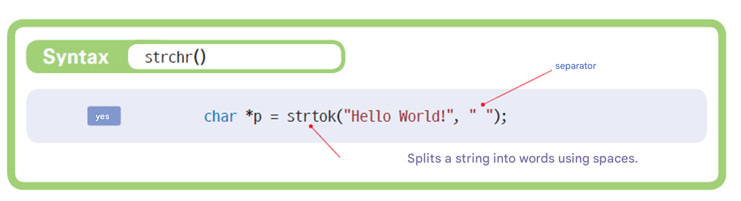
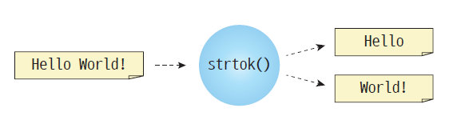
String tokenization
The strtok () function makes it easy to separate words from a sentence.

Slide 60
String tokenization
The strtok () function makes it easy to separate words from a sentence.
char[] s = “Man is immortal, because he has a soul” ;
t1 = strtok (s, “ “ ); // first th token : Man
t2 = strtok (NULL, " " ); // Second token : is
T3 = strtok (NULL, “ “ ); // Third token : immortal,
t4 = strtok (NULL, " " ); // fourth token : because

Slide 61
String tokenization
// strtok Example of using a function
#include < string.h >
#include < stdio.h >
char s[] = "Man is immortal, because he has a soul";
char seps [] = " ,\t\n";
char *token;
int main( void )
{
// string And pass it on next Token Get .
token = strtok ( s, seps );
while ( token != NULL )
{
// string In s The token present during Repeat .
printf ( " Token : %s\n" , token );
// next Token Get .
token = strtok (NULL, seps ); //
}
}
separator
Token : Man
Token : is
Token : immortal
Token : because
Token : he
Token : has
Token : a
Token : soul

Slide 62
Check points
Write a statement that copies string s1 to string s2.
What is the minimum size of a character array required to store a “String” ?
What is the function to compare strings ?
What is the difference between strcpy() and strncpy() ?
s2[] to the end of the string stored in s1[], what library function should I use and how ?
What is the return value of strcmp ("dog", "dog") ?

Slide 63
String to number conversion
String “36.5” and numeric value 36.5
They are stored quite differently within a computer.
3
6
.
5
\0
36.5
src [ 0] src [1] src [2] src [3] src [4] src[5]
v
String
Real number

Slide 64
sprintf () and sscanf ()
in front The attached s means string .
sscanf(str, “%f”, &v);
3
6
.
5
\0
36.5
v
src [ 0] src [1] src [2] src [3] src [4] src[5]
Real number
String
sprintf(str, “%f”, v);

Slide 65
Example
#include < stdio.h >
int main( void )
{
char instring []="file 12";
char name[10];
int number;
sscanf ( instring , "%s %d", name, &number);
printf ("name = %s \n", name);
printf ("number = %d \n", number);
return 0;
}
name = file
number = 12

Slide 66
Example
#include < stdio.h >
int main( void )
{
char buffer[50];
int x=10, y=20, result;
result = x + y;
sprintf (buffer, " Integer %d plus integer %d is %d .", x, y, result);
printf ("%s \n", buffer);
return 0;
}
Integers 10 plus integer 20 is 30.

Slide 67
Lab: Automatically generate video file names
Let's write a program that automatically generates file names .
image0.jpg
image1.jpg
image2.jpg
image3.jpg
image4.jpg
image5.jpg

Slide 68
Example
#include < stdio.h >
#include < string.h >
int main( void )
{
char filename[100];
int i ;
for (i=0; i < 6; i++){
sprintf (filename, "image%d.jpg" , i );
printf ( "%s \n" , filename);
}
return 0;
}
Create sequential file names .
image0.jpg
image1.jpg
image2.jpg
image3.jpg
image4.jpg
image5.jpg

Slide 69
Functions to convert a string to a number
The dedicated function is smaller than scanf() .
Prototype definition in stdlib.h - must be included
Function | explanation
int atoi( const char *str ); | Convert string to int type .
double atof( const char * str ); | Convert string to double type .
3
6
.
5
\0
36.5
src [ 0] src [1] src [2] src [3] src [4] src [5]
v
String
number

Slide 70
String to number conversion
#include < stdio.h >
#include < stdlib.h >
int main( void )
{
char s1[] = "100" ;
char s2[] = "12.93" ;
int i ;
double d, result;
i = atoi (s1);
d = atof (s2);
result = i + d;
printf ( " The result of the operation is %.2f .\n" , result);
return 0;
}
The result of the operation is 112.93.

Slide 71
Check points
Compare the memory space occupied by number 3.141592 and the string “3.141592”.
What functions can be used to convert the string “ 3.141592” to a real number ?
What is the difference between printf() and sprintf() ?

Slide 72
Array of strings
If I have multiple strings, what is the best structure to store them in ?
( Example ) “ init”, “open”, “close”, …
Two ways .
String array
Array of character pointers
“ init ”
“open”
“close”

Slide 73
1. String array
Column
char s[3][6] = {
"init",
"open",
"close"
};
i
n
i
t
\0
s [ 0][0] s [0][1] s [0][2] s [0][3] s [0][4] s [0][5]
o
p
e
n
\0
s [ 1][0] s [1][1] s [1][2] s [1][3] s [1][4] s [1][5]
c
l
o
s
e
\0
Row
s [ 2][0] s [2][1] s [2][2] s [2][3] s [2][4] s [2][5]

Slide 74
2. Array of character pointers
char *s[3] = {
"init ",
"open",
"close"
};
“ init ”
“open”
“close”

Slide 75
Example
#include < stdio.h >
int main( void )
{
int i ;
char menu[5][10] = {
" init " ,
"open" ,
"close" ,
"read" ,
"write"
};
for (i = 0; i < 5; i++)
printf ( "% dth menu : %s \n" , i , menu[ i ]);
return 0;
}
0th menu : init
1st menu : open
2nd menu : close
3rd menu : read
4th menu : write

Slide 76
Input as a two- dimensional array
#include < stdio.h >
int main( void )
{
int i ;
char fruits[3][20];
for ( i = 0; i < 3; i ++) {
printf ( " Enter the fruit name : " , fruits[ i ]);
scanf ( "%s" , fruits[ i ]);
}
for ( i = 0; i < 3; i ++)
printf ( "% dth fruit : %s\n" , i , fruits[ i ]);
return 0;
}
Don't put & in front
Enter the name of the fruit : apple
Enter the name of the fruit : Pear
Enter the name of the fruit : Grape
0th fruit : apple
1st fruit : pear
2nd fruit : grapes

Slide 77
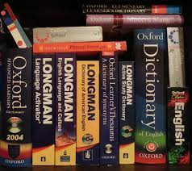
Lab: Korean-English Implementation of the dictionary
Let's implement a simple Korean-English dictionary using a three- dimensional string array .
Enter the word : boy
boy: boy

Slide 78
Implementation of Korean-English dictionary
#define ENTRIES 5
int main( void )
{
int i , index;
char dic [ENTRIES][2][30] = {
{"book", "책"},
{"boy", "소년"},
{"computer", "컴퓨터"},
{"lanuguage", "언어"},
{"rain", "비"},
};
char word[30];

Slide 79
Implementation of Korean-English dictionary
printf ( "Enter a word:" );
scanf ( "%s" , word);
index = 0;
for ( i = 0; i < ENTRIES; i ++)
{
if ( strcmp ( dic [index][0], word) == 0 )
{
printf ( "%s: %s\n" , word, dic [index][1]);
return 0;
}
index++;
}
printf ( " from dictionary Not found did not .\n" );
}
Enter a word : book
book: 책

Slide 80
Q & A

